Slide 1

Web Services, Part 02
Web services, part 02
Data serialization and JSON
Parameter passing
Example: web service for the movielens DB

Slide 2
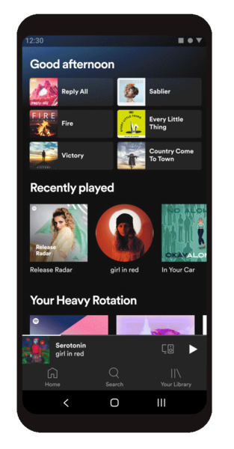


















Service-oriented architectures (SOA)
Redesign server-side as 1 or more services
Expose the services using web technologies (HTTP / HTTPS)

Slide 3
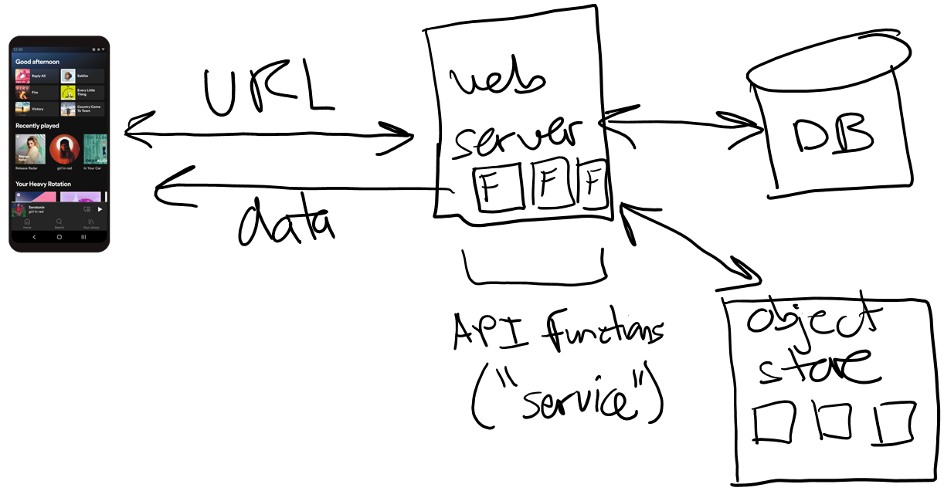
Performance?
Most important optimization in modern apps?
Minimize trips between machines
Client-to-server AND server-to-server within cloud
Size of payload (msg) much less important than trip itself
Minimize trips / API calls
Batch SQL queries into one SQL program
3

Slide 4
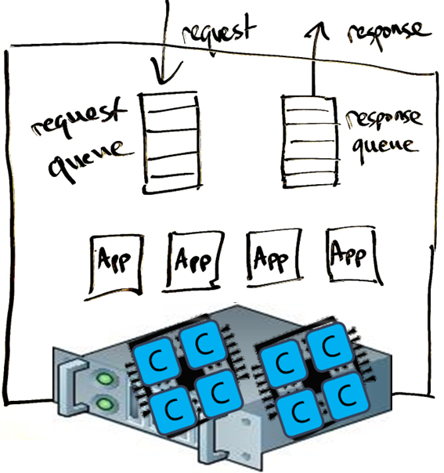
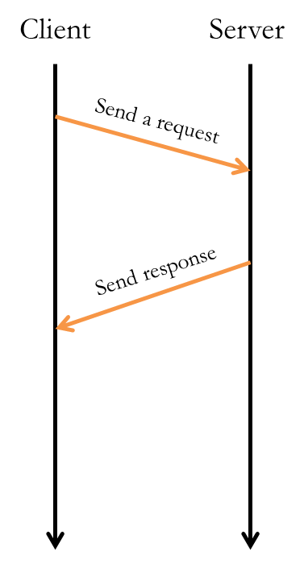
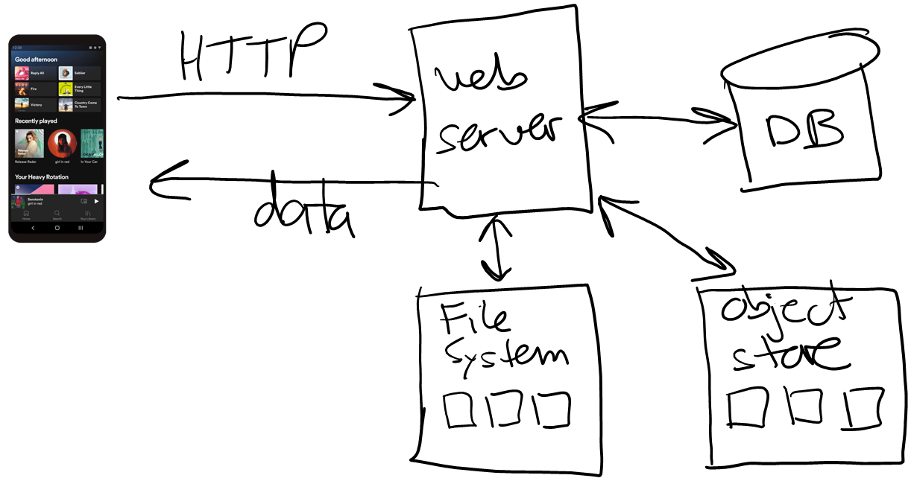
Why use Web Services for building applications?
Web community has already solved the problems designers face:
Support for concurrent users
Client-side configuration
Security / encryption
Supports most programming languages
Lots of programming frameworks
4

Slide 5




Example from last time
A simple calculator web service:
const express = require('express');
const app = express();
// main():
app.listen(3000, () => {
console.log('**SERVER: running...');
});
// increment x:
app.get('/incr/:x', (req, res) => {
try {
console.log('**call to /incr');
let x = parseInt(req.params.x);
if (isNaN(x))
throw new Error('x not a number');
let y = x + 1;
res.send(y.toString());
return;
}
catch(err) {
res.status(400).send(err.message);
}
});
import requests
url = 'http://localhost:3000/'
x = input('Enter integer x> ')
url = url + 'incr/' + x
response = requests.get(url)
print(response.text)
Notes:
Exception handling allows us to control the status code, and the response string…

Slide 6
HTTP requests and responses
6
Requests (most common)
GET: to request a data
POST: to post data to the server, and perhaps get data back
Response codes
200 OK: success
301 Moved Permanently
403 Forbidden
404 Not Found
500 Internal Server Error

Slide 7
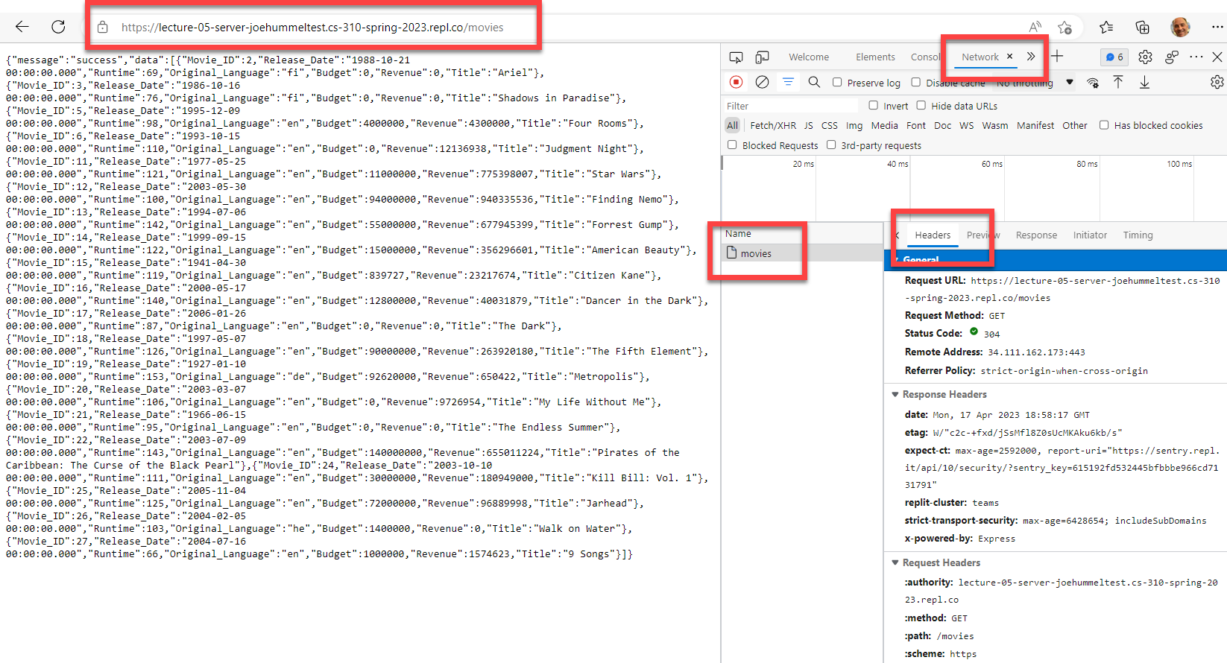
Viewing requests & responses
Use web browser's developer tools
Open browser, right-click on page, Inspect, Network tab, browse to URL

Slide 8
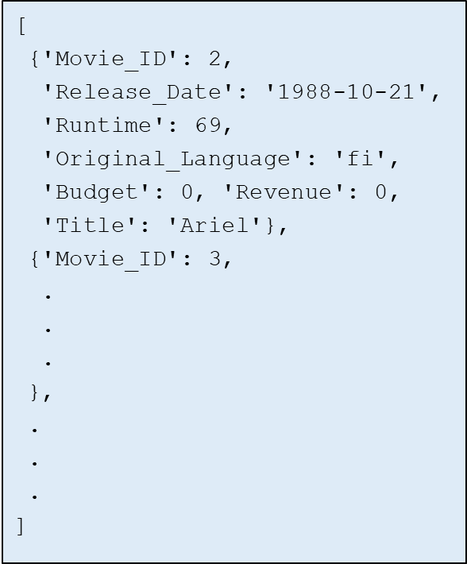



Serialization
Data needs to be sent over the network…
Serialization is the process of converting data / objects into a data stream that can be stored or transmitted over network…
we don't want to send 0's and 1's, the two computers may be different platforms --- e.g. Windows x86 and Mac M1 --- where data formats are different
JSON (JS object notation) is a common choice --- platform-neutral and language-neutral
SELECT * FROM Movies;
Movie Lens
8

Slide 9
JSON – JavaScript Object Notation
A data format used by most web services
Allows an arbitrary amount of nesting
Whitespace is ignored
Basic components are:
[] for ordered lists
Items are separated by commas
Items can be any JSON
{} for unordered dictionaries/objects
Key: value pairs are separated by commas
Keys must be strings (text)
Values can be any JSON
Numbers, true, false, null
Strings in quotes
[
{'Movie_ID': 2,
'Release_Date': '1988-10-21',
'Runtime': 69,
'Original_Language': 'fi',
'Budget': 0, 'Revenue': 0,
'Title': 'Ariel'
},
{'Movie_ID': 3,
.
.
.
},
.
.
.
]
Credits: slides from Prof. Tarzia's CS 310 materials
9

Slide 10
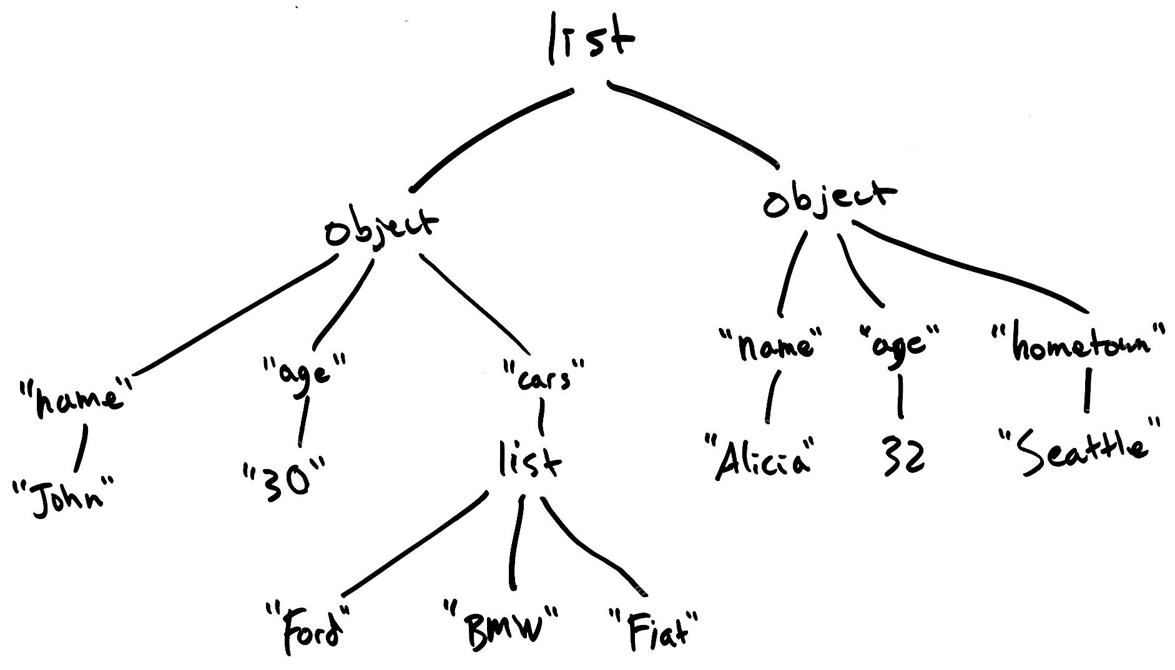
Example: JSON graph
[ { "name": "John", "age": 30, "cars": ["Ford", "BMW", "Fiat"] }, { "name": "Alicia", "age": 32, "hometown": "Seattle" } ]
10
Notes:
JSON might look "flat', but is really describing graphs (if you want)

Slide 11
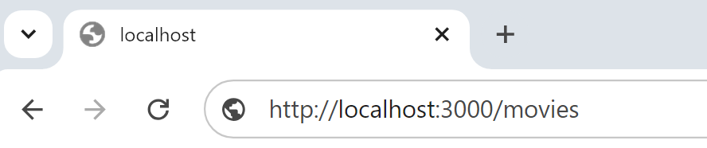
Sending a JSON response
const express = require('express');
const app = express();
// main():
app.listen(3000, () => {
console.log('**SERVER: running...');
});
// increment x:
app.get('/movies', (req, res) => {
try {
.
.
.
// send response in JSON format:
res.json( {"message": "success",
"data": rows} );
return;
}
catch(err) {
res.status(500).json({"message": …});
}
});

Slide 12
Parameter passing
URL parameters
Parameters required (they form part of the path)
More natural, easier to read?
//
// Retrieves top N movies having at least M reviews,
// but focusing on the given genre.
//
app.get('/movies/topNwithM/:genre', (req, res) => {
genre = req.params.genre;

Slide 13
Parameter passing (cont'd)
Two approaches
Query strings
Parameters are optional
Can have any # of params
//
// Retrieves top N movies having at least M reviews.
//
app.get('/movies/topNwithM', (req, res) => {
N = 10; // defaults:
M = 100;
if (req.query.N) {
N = parseInt(req.query.N);
}

Slide 14


Slide 15
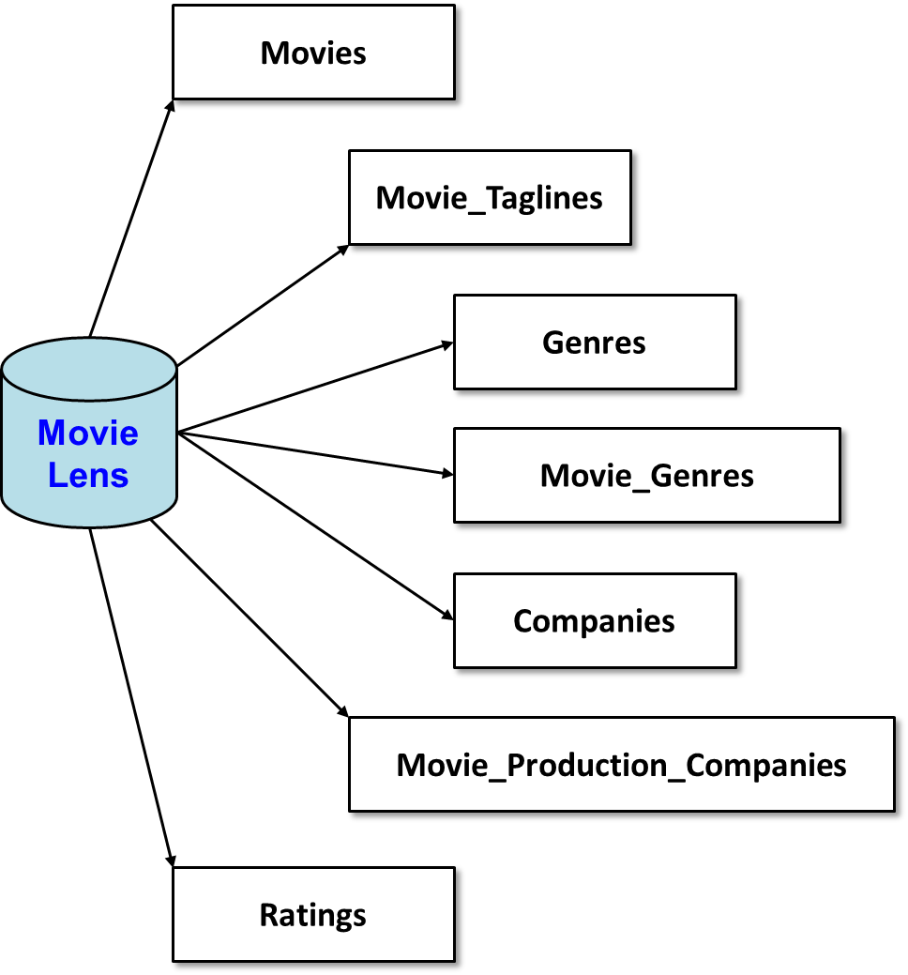
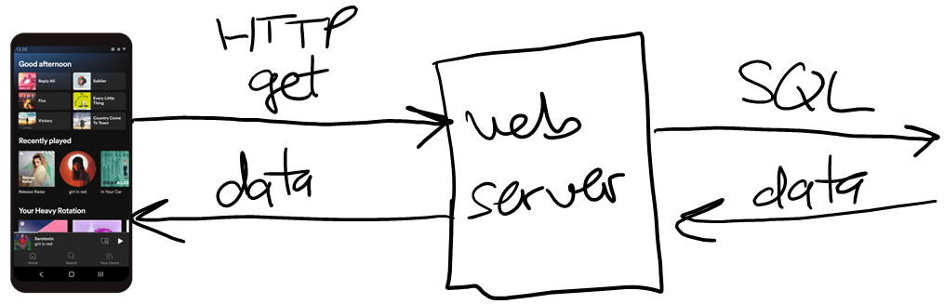
A more realistic Example
Let's build a web service for the MovieLens database
Notes:
Make it clear that

Slide 16


MovieLens web service
Movie Lens
app.get('/movies', (req, res) => {…});
app.get('/movies/top10', (req, res) => {…});
// top N with at least M reviews (defaults to N=10, M=100):
app.get('/movies/topNwithM', (req, res) => {…});
// top N with at least M reviews, in given genre:
app.get('/movies/topNwithM/:genre', (req, res) => {…});
.
.
.
Notes:
Make it clear that

Slide 17
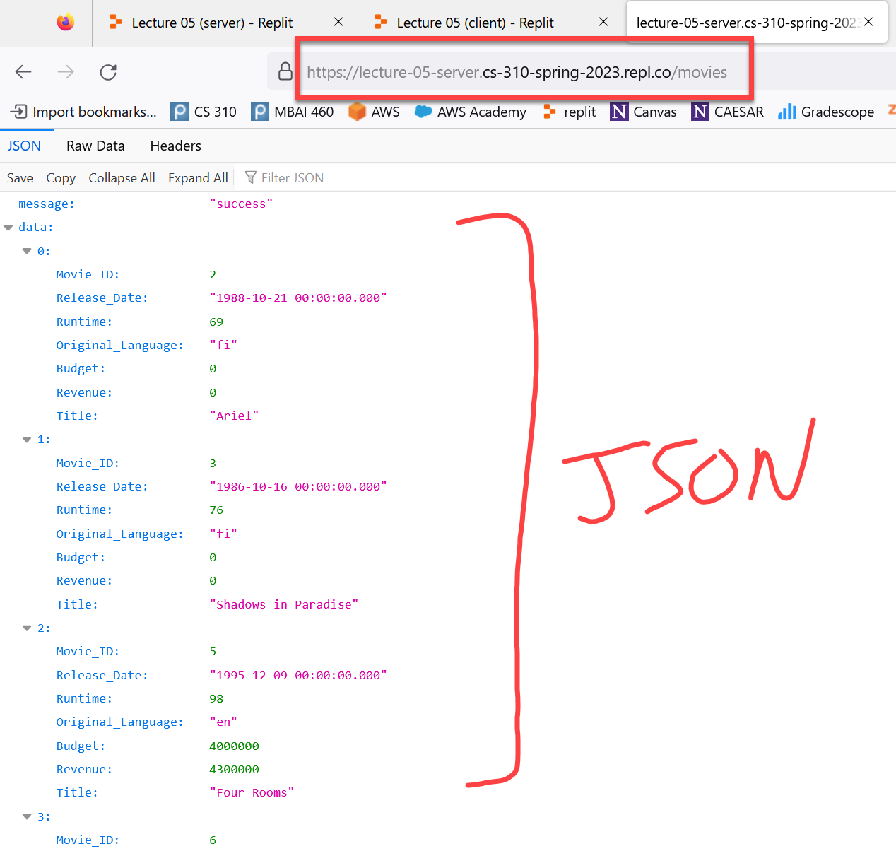
Demo using browser as client
Notes:
Start replit server…

Slide 18
Demo using browser as client
Notes:
Start replit server…

Slide 19
/movies
//
// Retrieve all movies in the database:
//
app.get('/movies', (req, res) => {
try {
console.log("**call to /movies");
let sql = "Select * From Movies Order By Movie_ID;";
let params = [];
// execute the SQL:
movielens.all(sql, params, (err, rows) => {
if (err) {
res.status(500).json( {"message": err.message, "data": []} );
return;
}
// send response in JSON format:
console.log("sending response");
res.json( {"message": "success", "data": rows} );
});
console.log("about to return");
return;
}
catch(err) { res.status(500).json({"message": err.message, "data": []}); }
});
Notes:
Don't point out the async nature just yet…

Slide 20
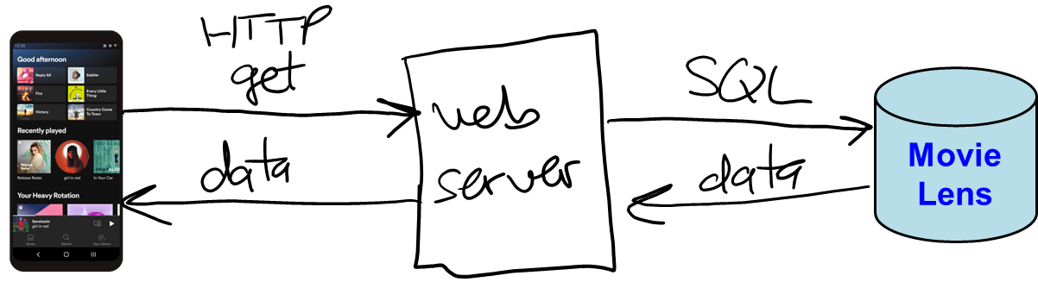
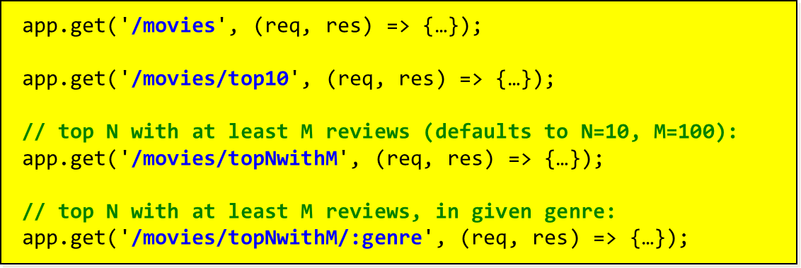
Other service functions
http://localhost:3000/movies/top10
http://localhost:3000/movies/topNwithM?N=5&M=50
http://localhost:3000/movies/topNwithM/Drama?N=3&M=200
Notes:
Make it clear that

Slide 21
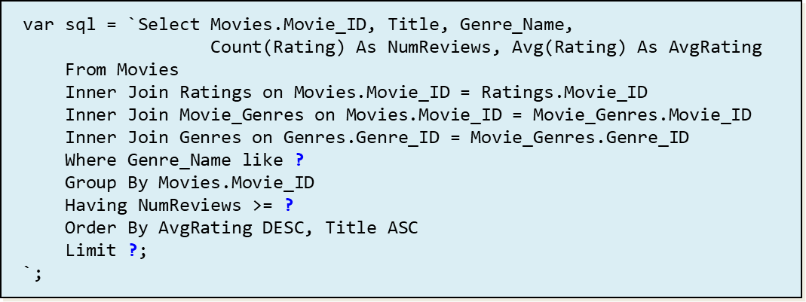
/movies/topNwithM/:genre
//
// Retrieve top N movies with at least M reviews, in
// the given genre. Defaults of N=10 and M=100.
//
app.get('/movies/topNwithM/:genre', (req, res) => {
try {
let N = 10; // defaults:
let M = 100;
let genre = req.params.genre;
if (req.query.N)
N = parseInt(req.query.N);
if (req.query.M)
M = parseInt(req.query.M);
let sql = `…`;
let params = [genre, M, N];
movielens.all(sql, params, (err, rows) => {
if (err) {
res.status(500).json({ "message": err.message, "data": [] });
return;
}
// send response in JSON format:
res.json({ "message": "success", "data": rows });
});
}
catch(err) { res.status(500).json({"message": err.message, "data": []}); }
});
Notes:
Ignore the async nature for now…

Slide 22
Invalid parameters?
//
// Retrieve top N movies with at least M reviews, in
// the given genre. Defaults of N=10 and M=100.
//
app.get('/movies/topNwithM/:genre', (req, res) => {
try {
let N = 10; // defaults:
let M = 100;
let genre = req.params.genre;
if (req.query.N)
N = parseInt(req.query.N);
if (req.query.M)
M = parseInt(req.query.M);
let sql = `…`;
let params = [genre, M, N];
movielens.all(sql, params, (err, rows) => {
if (err) {
res.status(500).json({ "message": err.message, "data": [] });
return;
}
// send response in JSON format:
res.json({ "message": "success", "data": rows });
});
}
catch(err) { res.status(500).json({"message": err.message, "data": []}); }
});
if (isNaN(N)) {
res.status(400).json({ message: "N is not a number",
data: [] });
return;
}
if (isNaN(M)) {
res.status(400).json({ message: "M is not a number",
data: [] });
return;
}
Notes:
Ignore the async nature for now…

Slide 23
Client-side
import requests
baseurl = 'http://localhost:3000' ## no / at the end
api_movies = '/movies'
api_top10 = '/top10'
api_topNwithM = '/movies/topNwithM'
# get all the movies:
url = baseurl + api_movies
response = requests.get(url)
# let's look at what we got back:
print(type(response))
print(response.status_code)
# deserialize to Python objects:
body = response.json()
print(type(body)) # dictionary
msg = body['message']
print("message:", msg)
movies = body['data']
print("# of movies:", len(movies))
for i in range(0,10): # print first 10 rows
print(movies[i])
{'message': …,
'data': … }

Slide 24
ORM
ORM = Object Relational Mapping
Relational data is often turned into client-side objects
import jsons
class Movie:
Movie_ID: int
Title: str
.
.
.
# deserialize to Python objects:
body = res.json()
rows = body['data']
movies = []
for i in range(0,10): # map to Movie objects:
m = jsons.load(rows[i], Movie)
movies.append(m)
for m in movies:
print(m.Movie_ID, ":", m.Title)
Notes:
Fields: Movie_ID, Title, Release_Date, Runtime, Original_Language, Budget, Revenue

Slide 25
Paging
There are 45,000 movies
Options:
Download all to client & display 1 page at a time
i = 0
pagesize = 10
N = len(movies)
#
# show movies one page at a time:
#
while i < N:
for r in range(i, min(i + pagesize, N)):
row = movies[r]
print(row["Movie_ID"], row["Title"])
i += pagesize
nextpage = input("Another page? [y/n] ")
if nextpage == 'n':
break
Is downloading 45,000 movies a good idea?
On a decent internet connection, yes. The general rule of thumb is to minimize trips to/from the server. ==> one BIG message is better than lots of smaller messages…

Slide 26
What if you want web server to paginate?
Options:
Use SQL's Limit clause
Client passes offset and page size to the server
Warning: the server still selects all the rows, then returns the rows you want. ==> slow if there are a large number of rows (millions?)
Use a WHERE clause on primary key
Client passes largest key from previous page, & pagesize
Much faster when you have large tables, but requires use of primary key / indexed column
SELECT *
FROM Movies
ORDER BY Movie_ID ASC
LIMIT offset, pagesize;
SELECT *
FROM Movies
ORDER BY Movie_ID ASC
WHERE Movie_ID > prevkey
LIMIT pagesize;

Slide 27
That's it, thank you!

Slide 28
MovieLens database
MovieLens
https://movielens.org/
45K movies
26M reviews
Movie Lens

Slide 29
Movies
Movie_Taglines
Genres
Movie Lens
Movie_Genres
Companies
Movie_Production_Companies
Ratings

Slide 30
Movie_ID | Title | Release_Date | Runtime | Original_Language | Budget | Revenue
603 | The Matrix | 1999-03-30 00:00:00.000 | 136 | en | 63000000 | 463517383
862 | Toy Story | 1995-10-30 00:00:00.000 | 81 | en | 30000000 | 373554033
Movies
Movie_ID | Tagline
603 | Welcome to the Real World.
605 | Everything that has a beginning has an end.
Movie_Taglines
Movie Lens
Ratings
Movie_ID | Rating
605 | 8
603 | 6
605 | 10
605 | 6

Slide 31
Company_ID | Company_Name
1885 | Silver Pictures
6194 | Warner Bros.
Movie_ID | Company_ID
603 | 1885
603 | 6194
862 | 3
Companies
Movie_Production_Companies
Movie_ID | Genre_ID
862 | 16
862 | 35
603 | 28
603 | 878
Movie Lens
Movie_Genres
Genres
Genre_ID | Genre_Name
28 | Action
878 | Science Fiction
16 | Animation
35 | Comedy

Slide 32
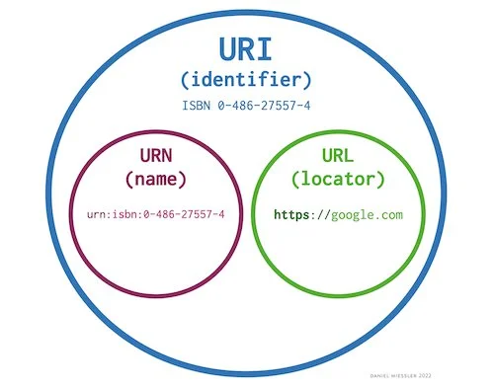
URI vs. URN vs. URL
Uniform resource identifier
Uniform resource name
Uniform resource locator
Technically our API paths are URIs…
Notes:
Because the path is not locating a resource, but identifying data…

Slide 33
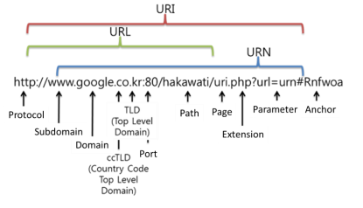
Routing

Slide 34
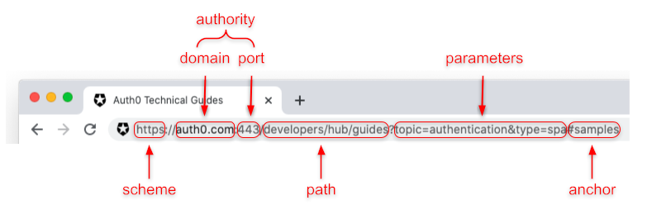

Slide 35
